Slide 1

Enhancing ASR Transcripts with
Visual Evidence and Domain
Knowledge
ML Project - Group 4 Progress Report
Notes:
Hello everyone. Welcome to our project presentation for Group 4. Today we're going to walk you through our course project on multimodal ASR transcript enhancement. This research explores how we can combine audio processing, computer vision, and language models to improve automatic speech recognition quality in challenging scenarios like technical lectures.

Slide 2
01
Research Motivation
Understanding limitations of pure audio-based ASR in technical contexts
Presentation
Overview
02
Current Implementation
Multimodal pipeline architecture with WhisperX and vision-language models
Multimodal ASR Transcript Enhancement: Technical
architecture, implementation details, and future research
directions.
03
Future Roadmap
Evaluation metrics, retrieval improvements, and engineering enhancements
Notes:
Before we dive in, let me outline what we'll cover today. First, we'll explain the research problem we're tackling—why ASR systems struggle with technical content and what additional information sources we can leverage. Then we'll walk through what we've built so far: our dataset, the processing pipeline, and the technical architecture. Finally, we'll discuss our roadmap for evaluation and system improvements.

Slide 3
The Research Question
Pure audio-based ASR systems face systematic limitations when processing technical content, particularly in misrecognizing domain-specific
terminology, proper names, and organizations that appear visually in slides or subtitles. This research investigates whether multimodal evidence—
combining low-confidence ASR outputs, video frame analysis, and domain glossaries—can provide sufficient contextual signals to repair these specific
error patterns without requiring full manual transcription.
1
Standard ASR models generate baseline transcripts for lectures and interviews but exhibit characteristic failure modes on technical terms and named entities that
are visually presented on slides or screens
2
Visual channels contain complementary evidence including slide text, subtitles, and on-screen graphics that remain inaccessible to audio-only processing
pipelines
3
Domain glossaries provide prior knowledge about specialized vocabulary, creating opportunities for context-aware disambiguation when acoustic signals are
ambiguous
4
The core hypothesis posits that timestamp-aligned fusion of audio confidence scores, visual evidence, and glossary matches can identify and correct high-error-
probability segments more effectively than single-modality approaches
Notes:
Let's start with the fundamental question we're investigating. When you watch a technical lecture or TED talk, the audio quality isn't always perfect, and the content is full of specialized terminology. Standard ASR models like Whisper can give you a baseline transcript, but they often miss technical terms or proper nouns. The question is: can we leverage the visual information in the video—like slides, subtitles, or on-screen text—plus some background knowledge, to fix these errors? This isn't about building a perfect system that works automatically every time. It's about exploring whether combining these information sources actually provides useful evidence for correcting transcripts.

Slide 4
Three Sources of Evidence
The proposed system adopts a multimodal fusion strategy that triangulates evidence across audio, visual, and knowledge modalities. ASR confidence scores identify
uncertainty zones requiring verification, video frame analysis extracts textual and semantic context from presentation materials, and domain glossaries provide authoritative
terminology references—creating a redundant evidence structure that compensates for individual modality limitations.
ASR Output with Confidence
Visual Frame Analysis
Domain Glossary
•
WhisperX provides word-level timestamps and
confidence scores, enabling targeted intervention
on low-probability segments rather than full-text
processing
•
Strategic frame sampling around scene transitions
and low-confidence timestamps captures
presentation slides containing textual
disambiguation cues
•
Curated background documents and terminology
lists provide authoritative reference for specialized
vocabulary common in technical presentations
•
Lightweight fuzzy matching against local glossary
enables rapid term verification without requiring
heavy vector database infrastructure in prototype
phase
•
Acoustic uncertainty often clusters around technical
terminology and proper nouns where phonetic
similarity creates ambiguity in domain-specific
contexts
•
Vision-language models extract visible text, identify
technical concepts, and provide semantic context
unavailable through audio channels alone
Notes:
To understand our approach, we need to look at the three types of information we're trying to combine. First, the ASR output gives us the baseline transcript with confidence scores. Low-confidence segments are exactly where we want to focus our repair efforts. Second, the video frames provide visual evidence. We're particularly interested in frames around scene changes or low-confidence segments, where the vision-language model can read text on slides or identify key visual concepts. Third, we have the domain glossary—a curated list of technical terms related to the video topic. This acts like a lightweight knowledge base for term verification. None of these sources is perfect alone, but together they might give us enough signal to make intelligent corrections.

Slide 5
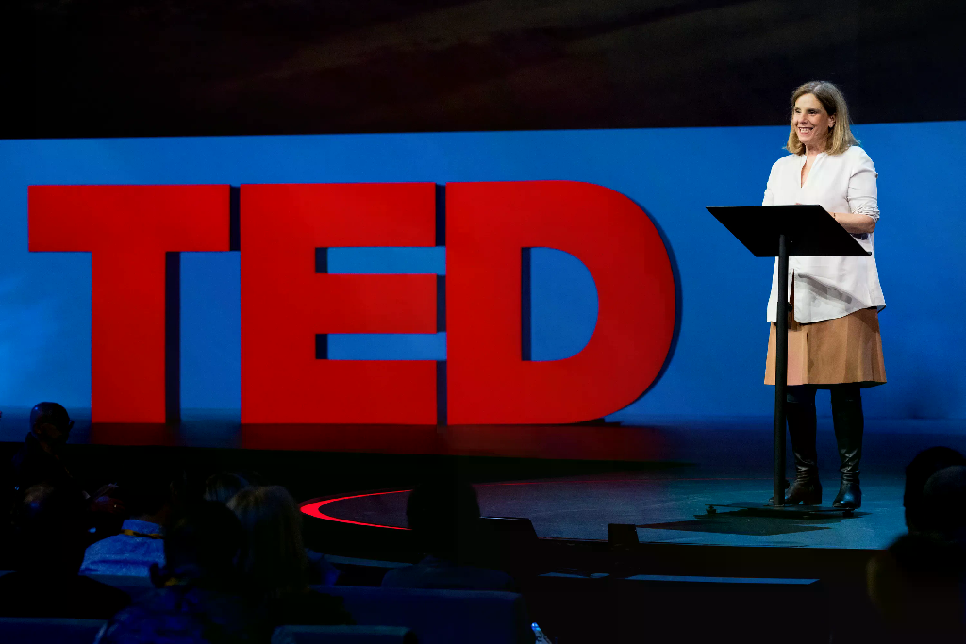
Dataset Construction
We compiled a specialized corpus of 10 AI/ML-focused TED/TED-Ed videos with comprehensive multimodal annotations. Unlike general-
purpose ASR datasets, each sample includes manually verified reference transcripts for accuracy evaluation, structured metadata for context
enrichment, and curated background documents enabling domain-specific retrieval—creating a targeted testbed for technical terminology
recognition challenges.
01
Curated 10 high-quality educational videos from TED and TED-Ed platforms
specifically selected for artificial intelligence and machine learning subject matter
02
Each sample includes complete video files, extracted audio tracks, manually verified
reference transcripts serving as evaluation ground truth, and structured metadata
documentation
03
Prepared domain-specific background documents including technical glossaries and
topic summaries to enable knowledge-augmented retrieval during processing
04
Implemented structured directory organization under data/ folder enabling
automated pipeline ingestion and reproducible experiment configuration
TED conference stage speaker presentation
Notes:
Moving on to what we've actually built. We started by creating a small but carefully curated dataset. We selected 10 TED and TED-Ed videos specifically focused on artificial intelligence and machine learning topics. For each video, we didn't just grab the file—we manually collected reference transcripts to serve as ground truth for evaluation, extracted metadata about speakers and topics, and prepared background documents for RAG retrieval. The dataset is stored in a structured directory format that our pipeline can read automatically. While 10 samples might seem small, it's actually sufficient for running end-to-end experiments and validating that our technical approach works before scaling up.

Slide 6
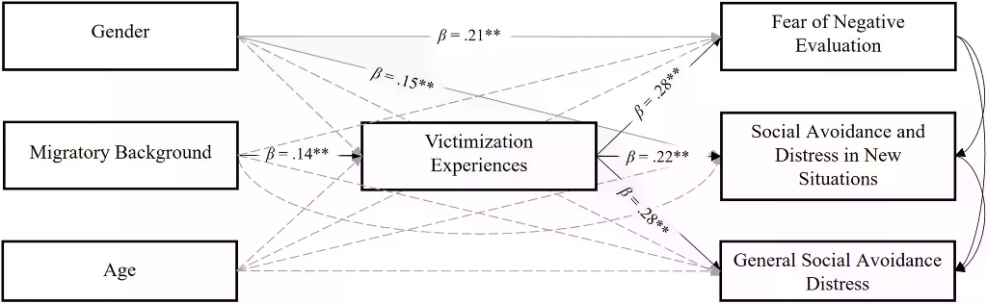
Pipeline Architecture
Core Design: A modular, stage-based architecture processing video through parallel audio
and visual tracks before fusing evidence for final repair. Timestamp-synchronized merging
preserves temporal alignment across modalities.
Audio Processing:
Track extraction feeds WhisperX for ASR transcription with word-level
timestamps and optional speaker diarization.
Visual Sampling:
Figure: Multimodal pipeline architecture with parallel processing tracks
Intelligent frame sampling targets scene transitions and low-confidence ASR
segments for analysis.
Visual Analysis:
Qwen3-VL-4B processes frames to extract visible text, identify terminology,
and generate evidence.
Evidence Fusion:
Timestamp-synchronized merging aligns ASR, visual data, and glossary
matches before Qwen3-8B generates output.
Notes:
Now let's look at the actual pipeline architecture. The system follows a sequential processing flow. We start with the raw video input. First, we extract and preprocess the audio, then feed it through WhisperX for initial transcription and speaker diarization. In parallel, we sample frames from the video—strategically selecting frames around scene changes and those low-confidence ASR segments I mentioned earlier. These frames go to Qwen3-VL, our vision-language model, which extracts visual evidence. Meanwhile, we query the local glossary using fuzzy matching for relevant terms. All three evidence streams—the ASR output, visual analysis, and glossary matches—get merged by timestamp. Finally, Qwen3-8B, our text repair model, takes this fused evidence and generates the corrected transcript, which we export as both JSON and Markdown for easy inspection.

Slide 7
Technical Stack & Model Configuration
The prototype integrates specialized models across four functional layers: WhisperX variants for audio processing with configurable model sizes, Qwen3-VL-4B for
visual understanding of presentation content, Qwen3-8B for generative text repair with evidence synthesis, and a lightweight fuzzy-matching retrieval layer using local
JSON glossaries. This architecture prioritizes modularity and API compatibility over monolithic integration.
Model Specifications
Component | Model/Tool | Purpose
ASR | WhisperX (base) | Audio transcription with timestamps
Diarization | pyannote (optional) | Speaker segmentation
Vision | Qwen3-VL-4B | Frame analysis & text extraction
Text Repair | Qwen3-8B | Transcript generation & correction
Retrieval | Fuzzy matching (JSON) | Domain term verification
01
WhisperX with configurable model sizes (base default, optional tiny/small/medium/large) provides ASR transcription with word-level timestamps and optional pyannote-based
speaker diarization requiring HuggingFace authentication tokens
02
Qwen3-VL-4B-Instruct handles visual frame analysis, extracting visible text, scene descriptions, and technical term identification from strategically sampled video frames
03
Qwen3-8B accessed via OpenAI-compatible API performs generative transcript repair, synthesizing ASR output, visual evidence, and retrieval results into corrected text
04
Lightweight RAG implementation currently uses local data/glossary.json with fuzzy string matching rather than vector embeddings, enabling rapid prototyping without
database infrastructure
Notes:
Let me break down the specific models and tools we're using. For ASR, we use WhisperX with the base model as default, though we can swap in larger models like medium or large if needed. It also handles speaker diarization through pyannote, though that requires HuggingFace authentication. For understanding what appears in the video frames, we use Qwen3-VL-4B-Instruct. This vision-language model can read text on slides, describe scenes, and identify technical terms visible in the frames. For the actual transcript repair—the text generation part—we use Qwen3-8B through an OpenAI-compatible API. It takes all the evidence we've gathered and rewrites the transcript. For retrieval, we're currently using a simple approach: a local JSON glossary file with fuzzy matching, not a full vector database yet. This keeps the prototype lightweight while we validate the concept.

Slide 8
Current Limitations & Prototype Status
The current implementation represents a functional proof-of-concept rather than a production system. Critical gaps include the absence of vector-
based retrieval infrastructure, dependency on external APIs for vision and language models creating latency and availability constraints, lack of user
interface requiring command-line operation, and absence of quantitative evaluation metrics to validate repair accuracy improvements over baseline
ASR.
RAG Infrastructure Limitation
External API Dependencies
Relies on local JSON glossaries with fuzzy string matching rather than embedding-
based vector retrieval, limiting semantic matching capabilities and scalability.
Vision analysis and text repair stages depend on external API calls or local model
hosting, introducing network latency, resource requirements, and potential availability
constraints.
CLI-Only Interface
Incomplete Evaluation
System operates via command-line interface and Makefile automation without web-
based GUI or batch processing capabilities, restricting accessibility for non-technical
users.
Large-scale quantitative evaluation remains incomplete: while pipeline functionality is
verified, Word Error Rate improvements and technical term accuracy metrics against
ground truth are not yet systematically measured.
Notes:
I want to be realistic about where we are. This is definitely still a prototype, not a production system. The RAG module is just a JSON file with fuzzy matching—it's not a real vector database with embeddings. The visual understanding and text repair steps require external API calls or local GPU resources, which adds latency and complexity. We don't have a web interface yet; everything runs through command line and Makefiles. And we haven't done large-scale quantitative evaluation—we know the pipeline runs, but we haven't measured exactly how much it improves accuracy. So think of this as a functioning experimental framework where we've validated that the pieces can work together, but there's significant engineering and evaluation work remaining.

Slide 9
Evaluation Framework
The immediate priority is establishing rigorous quantitative evaluation using the existing ground truth transcripts. Beyond standard Word Error Rate
metrics, we will implement specialized technical term accuracy measurements to validate domain-specific improvements, and analyze the correlation
between system-flagged low-confidence segments and actual error locations to verify the effectiveness of our targeted repair strategy.
1
Implement automated Word Error Rate calculation comparing baseline WhisperX output against repaired transcripts using manual reference as ground
truth
2
Develop specialized technical term accuracy metrics focusing on domain-specific vocabulary, named entities, and specialized terminology where ASR
typically underperforms
3
Analyze precision and recall of error detection: validate whether segments flagged by low ASR confidence and visual evidence actually contain higher
error rates than unflagged segments
4
Create visualization tools for error analysis including confusion matrices and segment-level comparison views to identify systematic failure patterns
Notes:
Looking ahead, our first priority is building a proper evaluation framework. Since we have those manual reference transcripts I mentioned, we can do rigorous quantitative analysis. We'll measure standard Word Error Rate comparing original WhisperX output against our repaired transcripts. But more importantly for our use case, we'll calculate technical term accuracy—how often do we correctly recognize domain-specific terms compared to the baseline? We also want to analyze whether the segments our system flags for review actually correlate with higher error rates. This will tell us if our confidence-based targeting is working. Essentially, we need to prove that all this multimodal complexity actually produces better results than just using WhisperX alone.

Slide 10
Enhanced Retrieval & Evidence
The retrieval layer will evolve from simple fuzzy matching to embedding-based vector search infrastructure, incorporating expanded knowledge
sources including speaker profiles, topic summaries, and slide OCR text. Critically, we will implement evidence strength scoring and confidence
thresholds to prevent over-correction, ensuring repairs only apply when visual and glossary evidence strongly contradict low-confidence ASR
hypotheses.
1
Vector Database Migration: Migrate from JSON-based fuzzy matching to production vector database (ChromaDB/Weaviate) with embedding-based
semantic retrieval enabling concept-level matching beyond string similarity.
2
Knowledge Base Expansion: Expand knowledge base beyond technical glossaries to include speaker biographical information, talk topic summaries,
and OCR-extracted text from presentation slides.
3
Evidence Strength Scoring: Implement evidence strength scoring mechanisms that weight visual confidence, retrieval match scores, and ASR
uncertainty to prevent aggressive over-correction of correct transcripts.
4
Conflict Resolution Rules: Develop conflict resolution rules for contradictory evidence sources, establishing priority hierarchies when visual text,
glossary entries, and ASR hypotheses disagree.
Notes:
The second major direction is improving our retrieval and evidence usage. Right now we're using simple string matching against a JSON file. We want to upgrade this to a proper vector database—something like ChromaDB or Weaviate—with actual embeddings. This will let us do semantic search rather than just exact matching. We also want to expand what goes into that knowledge base—not just technical terms, but speaker biographies, topic summaries, and even extracted text from the actual presentation slides. Finally, we need smarter rules for when to apply corrections. Right now we might be over-correcting—changing things that were actually right. We need confidence thresholds and evidence strength indicators to only apply repairs when we have high certainty.

Slide 11
Future Work: Engineering & Architecture
Engineering improvements focus on three pillars: operational scalability through batch processing and standard format support, architectural
modernization transitioning from linear pipelines to flexible Agent-based workflows with improved observability, and enhanced robustness in speaker
diarization for multi-speaker scenarios.
Batch Processing & Formats
Agent-Based Architecture
Implement batch processing capabilities for multi-video workloads and extend
export format support to include SRT and VTT subtitle standards for
interoperability with existing video tools.
Refactor sequential pipeline into modular Agent-based architecture enabling
dynamic routing, improved debugging visibility, and easier extension of
processing capabilities.
Speaker Diarization
Web Interface
Enhance speaker diarization module to handle overlapping speech and speaker
transitions more robustly, particularly for interview and panel discussion formats.
Develop lightweight web interface for non-technical users while maintaining CLI
access for power users and automation workflows.
Notes:
Finally, we have a list of engineering improvements to make this more usable. We need batch processing—right now we process one video at a time. We want to support standard subtitle formats like SRT and VTT, not just our custom JSON and Markdown. The speaker diarization needs work to handle overlapping speech better. And if time allows, we want to refactor the current linear pipeline into a proper Agent workflow. Think of it as moving from a fixed assembly line to a flexible system where components can call each other based on context. This would make debugging easier and the system more extensible. We might even build a simple web interface so you don't need to use the command line.

Slide 12
Thank you for listening!
ML Project - Group 4 Progress Report
Notes:
Hello everyone. Welcome to our project presentation for Group 4. Today we're going to walk you through our course project on multimodal ASR transcript enhancement. This research explores how we can combine audio processing, computer vision, and language models to improve automatic speech recognition quality in challenging scenarios like technical lectures.

